Slide 1

CMPP 257
Introduction to JavaScript & JQuery
Module 2: Decisions & Functions in JavaScript
Dr. Hamdy Ibrahim
CMPP 257: Introduction to JavaScript & JQuery

Slide 2
Outlines
If Statement and its Forms.
Conditional (Ternary) Operator
Switch Statement.
Function Concepts
  Definition & Calling a Function
  Function Parameters & Return Value
  Variable Scope: Global vs. Local
CMPP 257: Introduction to JavaScript & JQuery

Slide 3



Decision Statements
Decision
The Choice of which Statements will be executed
Based on a Condition(s)
If Condition(s) is True → Statement1(s) will be executed
If Condition(s) is False → Statement2(s) will be executed
CMPP 257: Introduction to JavaScript & JQuery

Slide 4


Decisions: If Statement – 1st Form
Syntax
if (Condition) {
Statement 1;
Statement 2;
Statement m;
}
grade >= 50
true
Display “Passed”
Example
Continue Script
if (grade >= 50) {
document.write(‘You passed!’);
}
Other JS Statements;
CMPP 257: Introduction to JavaScript & JQuery

Slide 5
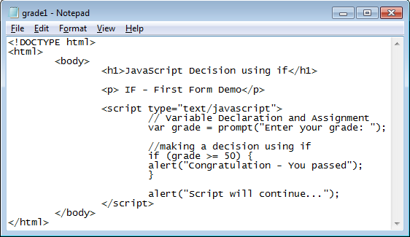
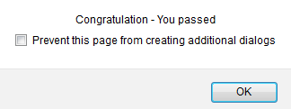
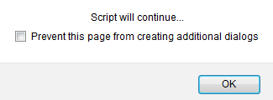


Decisions: If Statement – 1st Form
Will Show up If grade>= 50
Will Show up All the time
CMPP 257: Introduction to JavaScript & JQuery

Slide 6
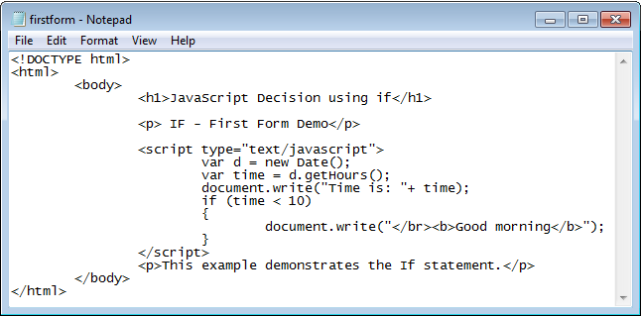
Decisions: If Statement – 1st Form
Trace the script and guess the output
CMPP 257: Introduction to JavaScript & JQuery

Slide 7

Decisions: If Statement – 1st Form
var price = parseInt(prompt("What is your merchandise total? ")); if (price > 1.00 && price < 25.00)
var ship = 5.00;
if (price >= 25.00 && price < 50.00)
var ship = 7.00;
if (price >= 50.00 && price < 75.00)
var ship = 9.00;
if (price >= 75.00 && price < 100.00)
var ship = 10.00;
if (price >= 100.00)
var ship = 0.00;
document.write("<p>Your shipping cost will be $ " + ship + ".</p>");
{} is used in case of block of statements
All conditions will be checked
CMPP 257: Introduction to JavaScript & JQuery

Slide 8

Decisions: If Statement – 2nd Form
Syntax
Example
if (Condition) {
Set 1 of Statements;}
else {
Set 2 of Statements;
}
if (grade >= 50) {
document.write(‘You passed!’);
} else {
document.write(‘You Failed’);
}
false
true
Display “Failed”
grade >= 50
Display “Passed”
Continue Script
CMPP 257: Introduction to JavaScript & JQuery

Slide 9
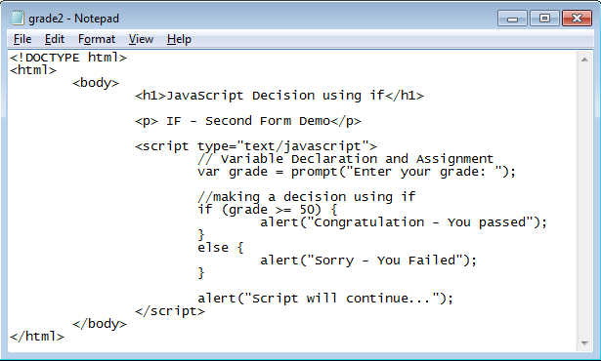

Decisions: If Statement – 2nd Form
If True
If False
CMPP 257: Introduction to JavaScript & JQuery

Slide 10

Decisions: If Statement – 3rd Form
Condition(s)
true
Block of Code executed if condition is True
false
Condition(s)
true
Block of Code executed if condition is True
false
Block of Code executed if condition is True
if – else – if Statement OR switch
Continue Script
CMPP 257: Introduction to JavaScript & JQuery

Slide 11

Decisions: If Statement – 3rd Form
if (Condition) {
Set 1 of Statements;
} else if (condition) {
Set 2 of Statements;
} else {
Set 3 of statements;
}
Syntax
var rate = parseInt(prompt("Rate the site from 1 to 10, with 10 as the best")); var grade = " “; // initialize grade
if (rate == 10)
grade = "A";
else if (rate >= 7 && rate <= 9)
grade = "B";
else if (rate >= 4 && rate < 7)
grade = "C";
else
grade = "D";
document.write("<p>You gave the site a rating of " + grade + ".</p>");
CMPP 257: Introduction to JavaScript & JQuery

Slide 12
Decisions: If Statement – 3rd Form
Write a script which:
Prompt the user for a grade
Only accept positive grade (grade>0)
Use if-else-if to show his grade letter (A, B, C, D, or F)
Task 1
Average Grade | Letter
Grade < 60 | F
Grade>= 60 and Grade < 70 | D
Grade>= 70 and Grade < 80 | C
Grade>= 80 and Grade < 90 | B
Grade >=90 | A
CMPP 257: Introduction to JavaScript & JQuery

Slide 13

Decisions: If Statement
Any Thing that can be Tested
Example → Score < 50
Evaluated to True or False
Could be One Condition or More
Variable | Comparison Operator | Literal Value/Variable
score | < | 50
score1 | <= | score2
CMPP 257: Introduction to JavaScript & JQuery

Slide 14

Decisions: If Statement
Comparison Operators
Operator | Description | Example (var score = 50) | Returns
== | Equal to | Score == 50 | True
 |  | Score == “50” | True
=== | Equal value and equal type | Score === 50 | True
 |  | Score === “50” | False
!= | Not Equal | Score != 80 | True
!== | Not equal value or not equal type | Score !== 50 | False
 |  | Score !== “50” | True
 |  | Score !== 80 | True
 |  | Score !== 50 | False
CMPP 257: Introduction to JavaScript & JQuery

Slide 15
Decisions: If Statement
Comparison Operators
Operator | Description | Example (var score = 50) | Returns
> | Greater than | Score > 40 | True
 |  | Score > 50 | False
< | Less than | Score < 60 | True
 |  | Score < 50 | False
>= | Greater than or equal to | Score >= 50 | True
 |  | Score > 40 | True
 |  | Score >= 60 | False
<= | Less than or equal to | Score <= 50 | True
 |  | Score <= 60 | True
 |  | Score <= 40 | False
CMPP 257: Introduction to JavaScript & JQuery

Slide 16





Decisions: If Statement – Logical Operators
AND
OR
Cond 1 && Cond 2
Cond 1 | Cond 2 | Result
False | False | False
False | True | False
True | False | False
True | True | True
Cond 1 || Cond 2
Cond 1 | Cond 2 | Result
False | False | False
False | True | True
True | False | True
True | True | True
(&&, ||) used to Combine Conditions
Cond 1 | ! (Cond 1)
False | True
True | False
NOT
CMPP 257: Introduction to JavaScript & JQuery

Slide 17
Decisions: If Statement
1. Modify the script in slide 6 to display different greetings (good morning, good afternoon, etc.) according to the current hour.
Task 2
1- Prompting the user to enter two numbers
2- Enter add, subtract, multiply, or divide
3- Perform the operation and display the result using write()
Task 3
CMPP 257: Introduction to JavaScript & JQuery

Slide 18

Decisions: Conditional Operator
Ternary Operator → (?)
Takes 3 Operands
variablename = (condition) ? value1:value2
Could be One Condition or More
Condition | ? | Exp1 : Exp2;
(time <10) | ? | True : false;
"The fee is " + (isMember ? "$2.00" : "$10.00")
CMPP 257: Introduction to JavaScript & JQuery

Slide 19
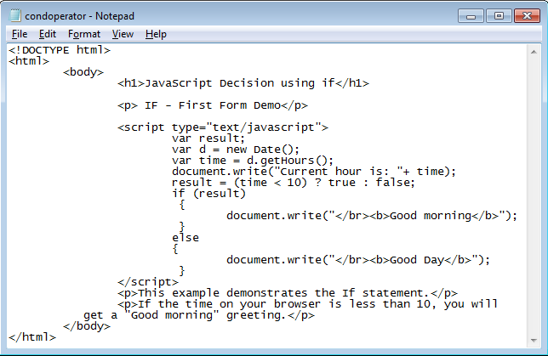

Decisions: Conditional Operator
If True,
result = true
CMPP 257: Introduction to JavaScript & JQuery

Slide 20

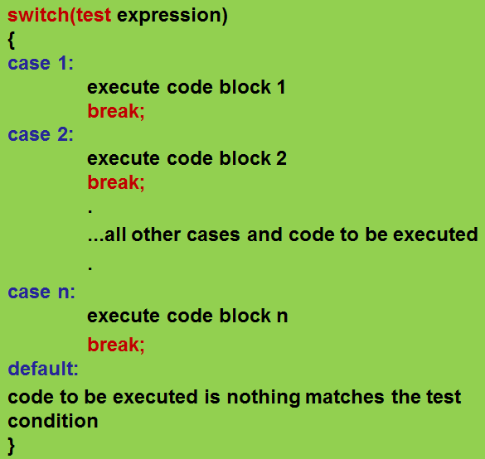
Decisions: switch
Same Function as if-else-if
Multi-Level Conditional
switch (valChoice)
{
case -1:
alert("negative");
break;
case 0:
alert("zero”);
break;
case 1:
alert("positive");
break;
default:
}
CMPP 257: Introduction to JavaScript & JQuery

Slide 21
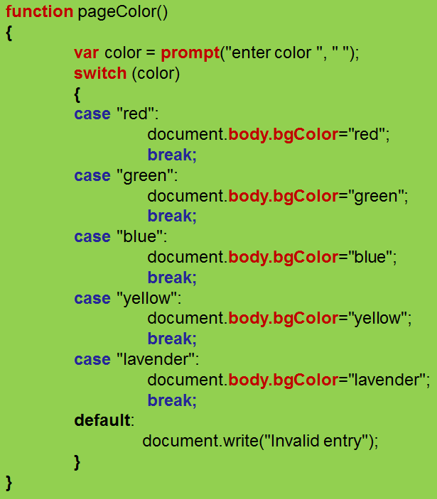
Decisions: switch
Changing background color of the body
CMPP 257: Introduction to JavaScript & JQuery

Slide 22
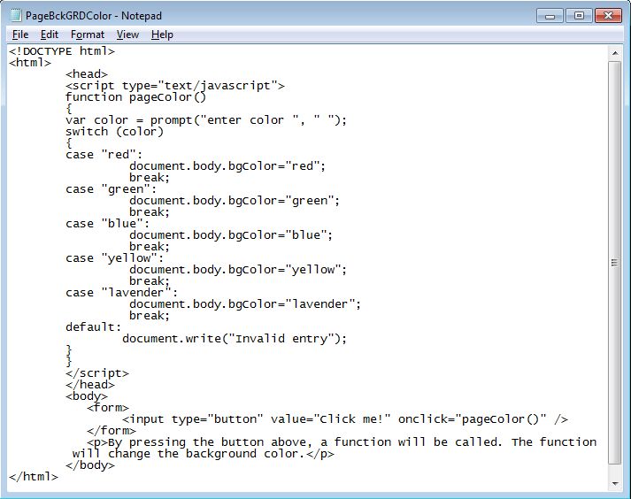
Decisions: switch
Changing background color of the body
CMPP 257: Introduction to JavaScript & JQuery

Slide 23
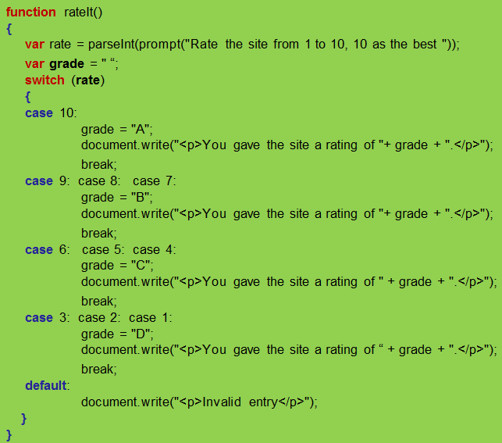
Decisions: switch
CMPP 257: Introduction to JavaScript & JQuery

Slide 24
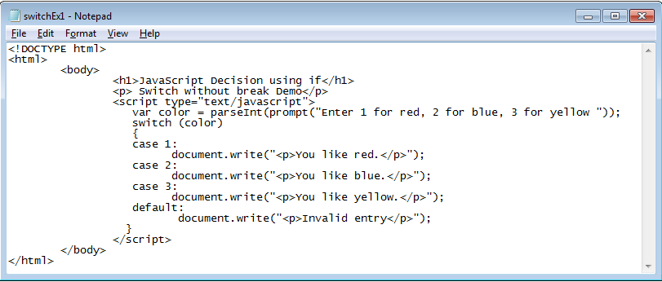
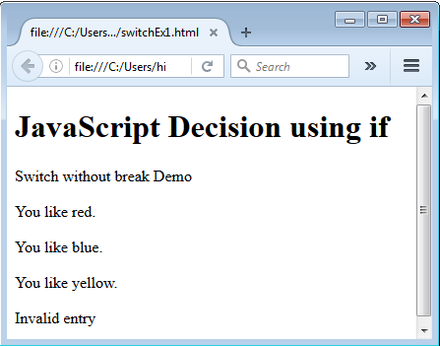
Decisions: switch
Without the break statement, all following cases will be executed!
CMPP 257: Introduction to JavaScript & JQuery

Slide 25

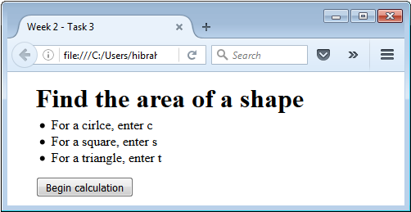
Decisions: switch
Task 4
Circle → area = PI * radius * radius;
Square → area = length * width;
Triangle → area = 0.5 * base * height;
CMPP 257: Introduction to JavaScript & JQuery

Slide 26

Functions
Group of Statements → Perform Task
Executed by a Condition/Unconditional Call
Can be Called anywhere
Recommended to be Defined in <HEAD>
Function Returns Only One Value
Reusable → Saving Time
Easier to read, understand, and maintain
CMPP 257: Introduction to JavaScript & JQuery

Slide 27

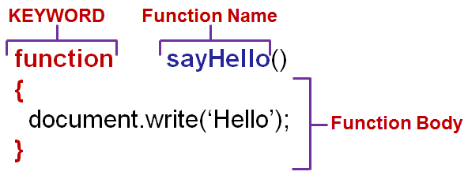
Functions: Usage
1. Declaration/ Definition
Function has Header & Body
CMPP 257: Introduction to JavaScript & JQuery

Slide 28


Functions: Usage
2. Function Calling
Use Function Name to Call→ sayHello();
Functions Types
Built-In:
parseInt() parseFloat()
User-Defined:
getInput()
product(a,b)
CMPP 257: Introduction to JavaScript & JQuery

Slide 29
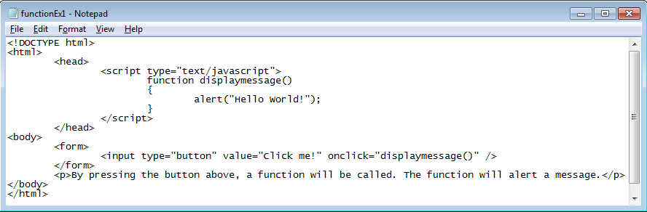
Functions: Example
CMPP 257: Introduction to JavaScript & JQuery

Slide 30
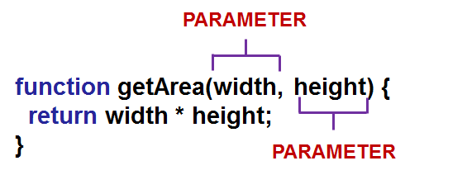

Functions: Receiving Data
Include Variables in Function Header
THE Parameters Are Used Like Variables
Calling
getArea(3, 5); // 3 and 5 are arguments
CMPP 257: Introduction to JavaScript & JQuery

Slide 31
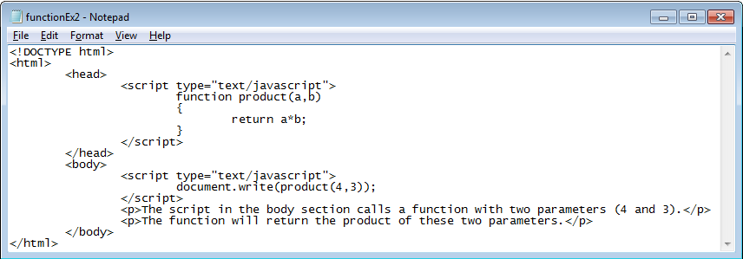
Functions: Example
Two Parameters: a,b
Return Value: a*b
product(4,3) will be replaced by a*b
Passed Values: 4,3
product(4,3) will be replaced by a*b
CMPP 257: Introduction to JavaScript & JQuery

Slide 32

Functions: Variable Scope
Part of script in which a variable can be accessed/referenced
Global: Variable is declared outside of functions and is accessible anywhere in the script
Local: Variable is declared inside a function and is only accessible within the function
Local More Efficient than Global
CMPP 257: Introduction to JavaScript & JQuery

Slide 33
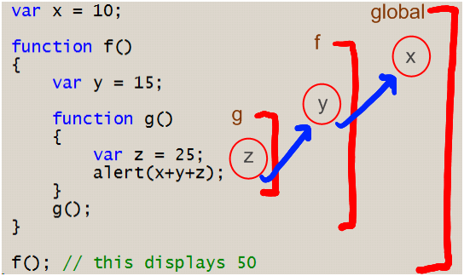
Functions: Variable Scope
Global: The variable will exist from the declaration until the end of the script.
Local: The Variable will only exist while the function is running.
CMPP 257: Introduction to JavaScript & JQuery

Slide 34

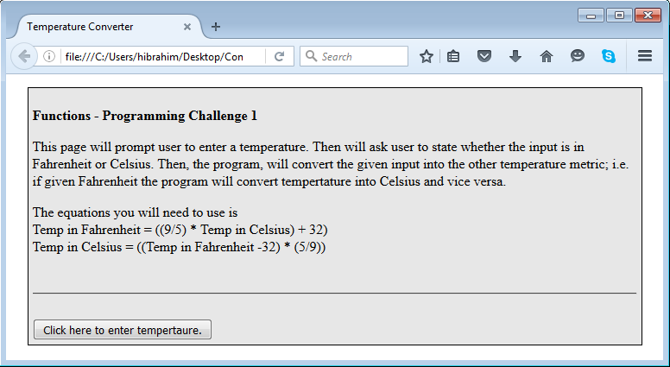
Functions
Task 5: Use Functions
CMPP 257: Introduction to JavaScript & JQuery

Slide 35
Functions
Task 6: Use Functions
Create a page which will prompt user to enter a course average (i.e. 86.4). This will then be converted to a letter grade based on the conversion table given in this Programming Challenge's description.
Average Grade | Letter
Grade < 60 | F
Grade>= 60 and Grade < 70 | D
Grade>= 70 and Grade < 80 | C
Grade>= 80 and Grade < 90 | B
Grade >=90 | A
CMPP 257: Introduction to JavaScript & JQuery

Slide 36

Thank You
Questions?
CMPN 215: Introduction to WEB Development

